Slide 1
Git Basics
Aaron S. Crandall

Slide 2

What is Git: Version Control and More
What is Version Control and why do we need it?
Have you ever had this happen during your work:
myProj.cpp
myProj.cpp-bakup
myProj.cpp-NotWorking
myProj-final.cpp
myProj-finalfinal.cpp

Slide 3
The Goals of Version Control
Keep a history of every document in a project
Allow a user to edit their document locally on this computer and publish the results
Have access to the changes to each document
Log which users made which changes on a line-by-line basis
Enable synchronizing work between multiple users
Version control system can:
Tie into individual IDEs
Foster development methodologies like unit testing and automatic deployment
Help manage releases like versions of products (i.e. MyPackage v2.3.8-ac4)

Slide 4
Git provides these features
Document repository with line-by-line change tracking
Protocol for synchronizing between repositories
Changes are logged with who made them
Development branches allow for ‘sandboxing’ of work
Merging between branches allows users/devs to integrate changes into a final product
Many IDEs, command line tools, and web interfaces are available to make Git easier to use

Slide 5
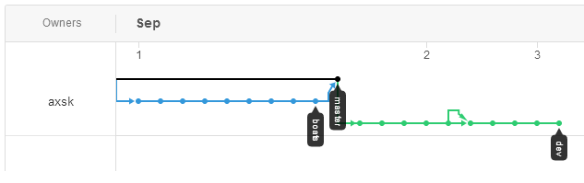
How is Git Structured?
The unit of operation for Git is a repository (repo)
All operations are done on the repo
A single repo represents a project of some size (any size!)
Within a repo, git keeps a series of versions, each represented by a commit

Slide 6
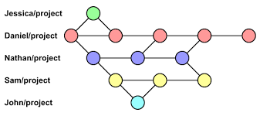
Branches - It’s a TREE!
The version history is kept in one or more branches
Each branch can have its own updates and changes
The goal is to create a branch to do some work, then merge those changes back when they’re done
Because branches are managed independently of each other, it allows collaboration
We can each branch from the original code, work on our own parts, and then merge our changes together
If you work directly on the same branch together, you’ll get merge conflicts and have to resolve them by hand (less fun)
FYI: Forking is not Branching
Forking is for whole repos
Branching is within a single repo

Slide 7
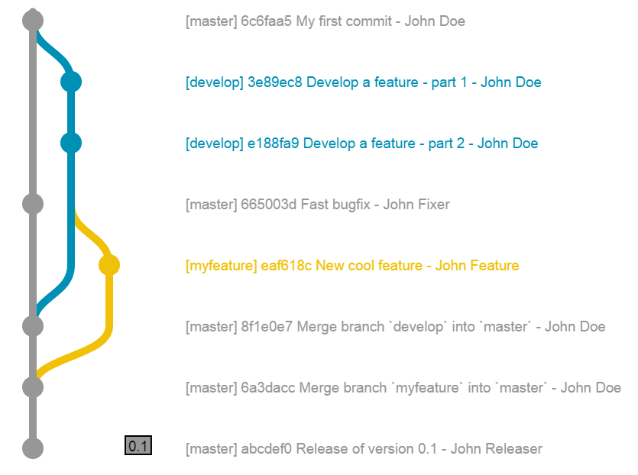

Slide 8
A note about users
By default you don’t need user accounts in git (this seems counter to most experiences)
Git is designed to be truly and wholly distributed with no central server
That means the name and email on a commit is entirely up to the user with no related authentication
That said, most users have a central server hosting their repos and that has user accounts
Before you can use git on a computer, it’ll ask for your name and email
These will be attached to any commits you generate
This can be done globally or on a per-repository basis (work vs. school vs. open source dev, etc)
git config --global user.name “Aaron Crandall” git config --global user.email acrandal@wsu.edu

Slide 9
What does a repo look like?
It’s a directory
… with a .git directory hiding in it that keeps track of the repo

Slide 10
Git servers: local vs. remotes
By default, a git repo is entirely local to your computer
But! It gets much more powerful if you use a server to host the repo so people can collaborate more easily through pushing and pulling updates of the repo
Servers: gitlab.com, github.com, bitbucket.org, gitlab.eecs.wsu.edu
The web interface can do almost everything you can do on the command line, except the software development itself
You clone a repo off of the server onto your machine
The cloned repo remembers where it came from (the remote) so you can push and pull changes

Slide 11
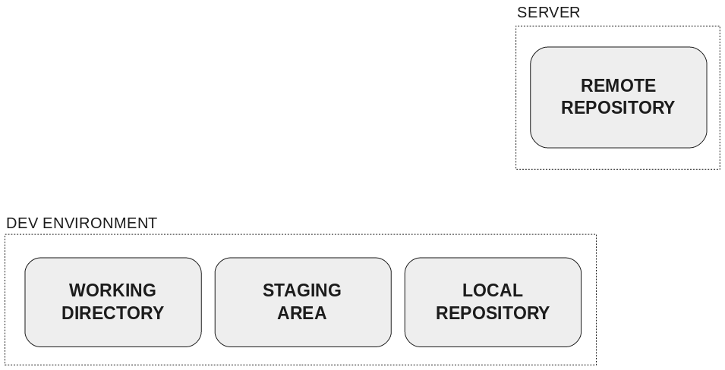
Why this pattern? It should just Dropbox copy!!!
Dropbox doesn’t allow for branches or versions
Git allows you to manage specific changes, not all changes like a cloud filesystem
You *choose* the files and changes to commit from the working directory
These then become staged for commit
Untracked files vs. Tracked files
Staged vs unstaged changes
Committed changes
I love some dropbox, but git solves dev work, not just backing up files

Slide 12
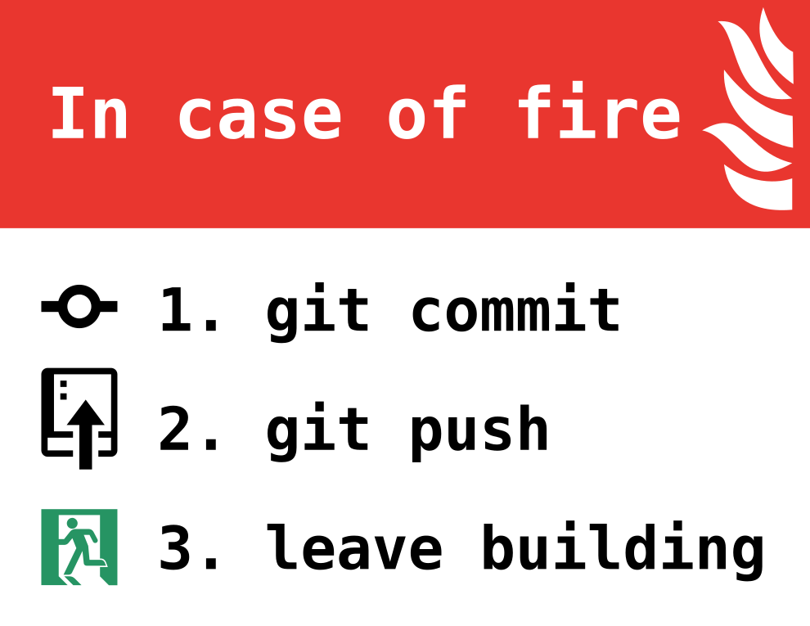
Onto the good stuff!
How to edit your repo and push the changes up to the server (the upstream)
Edit your files locally - VIM, VScode, VS, nano, pico, kdevelop, eclipse, Code::Blocks……………….. Emacs
Build and test your changes
Ready? - Okay, time to add, commit, push
git add [filename] -- This stages your changes to be ready for committing
git commit -m “message” -- This creates a new version of your project on the current working branch
git push -- This pushes your new commit(s) & branches to the server
Between each stage (even before the add), run ‘git status’
That’ll dump what’s added (staged), changed, and untracked
It’ll let you know which branch you’re on (like git branch does) and more details
READ the output of the tools - they often tell you exactly what to do next

Slide 13
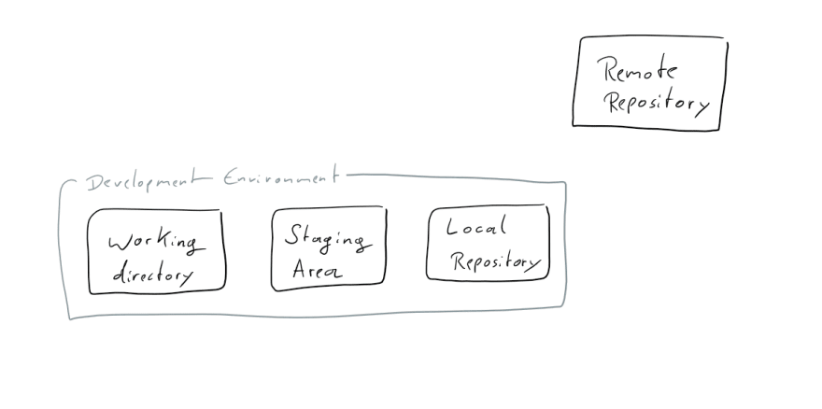
Git Concepts
https://dev.to/unseenwizzard/learn-git-concepts-not-commands-4gjc

Slide 14
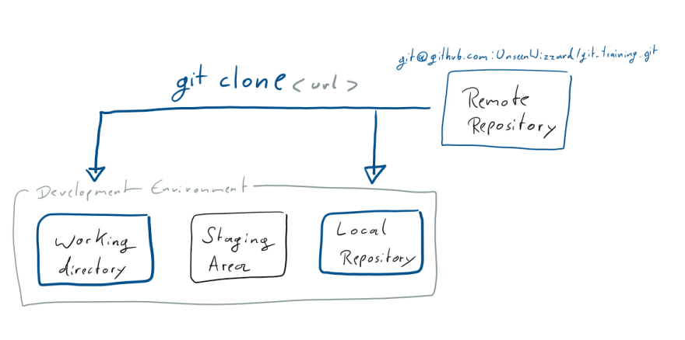
git clone “git repository URL” --- NOT the SSH URI!*
* Setting up SSH keys is definitely suggested for future work

Slide 15
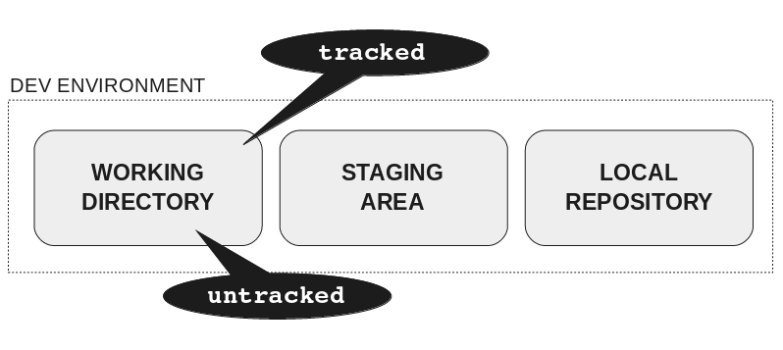
A piece of terminology - there’s both tracked and untracked files. Untracked ones are in the working directory, but have not been added (ever) to the Git repo itself.

Slide 16
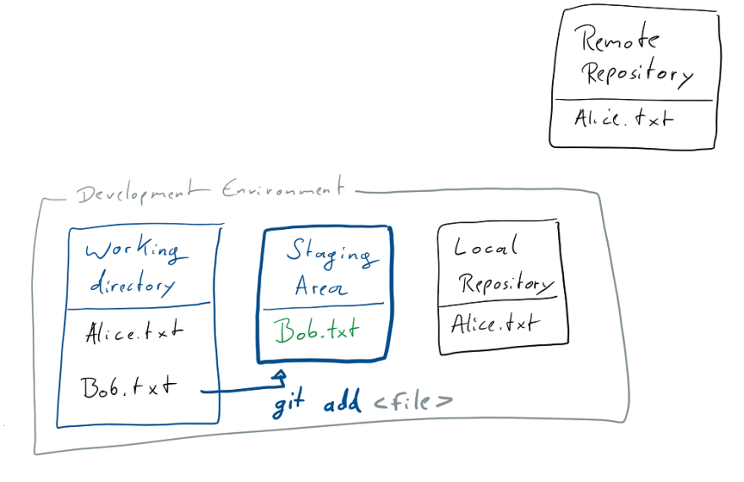
After added two new files, I decide to start “tracking” one (bob.txt) by running: git add bob.txt

Slide 17
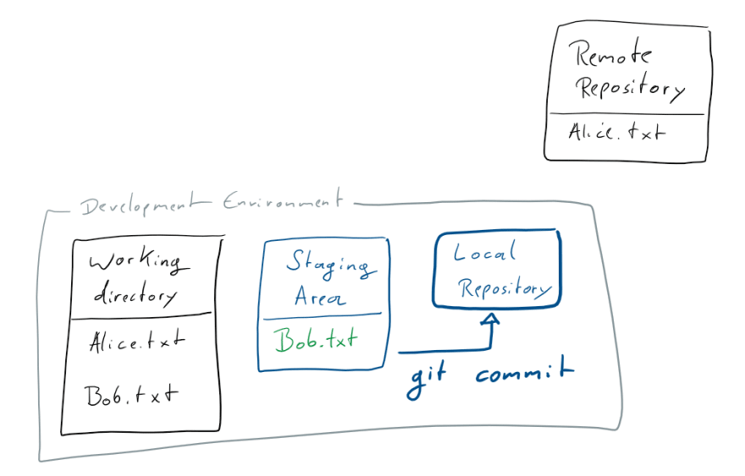
Now commit the change to our Local repo: git commit -m “Add Bob”

Slide 18
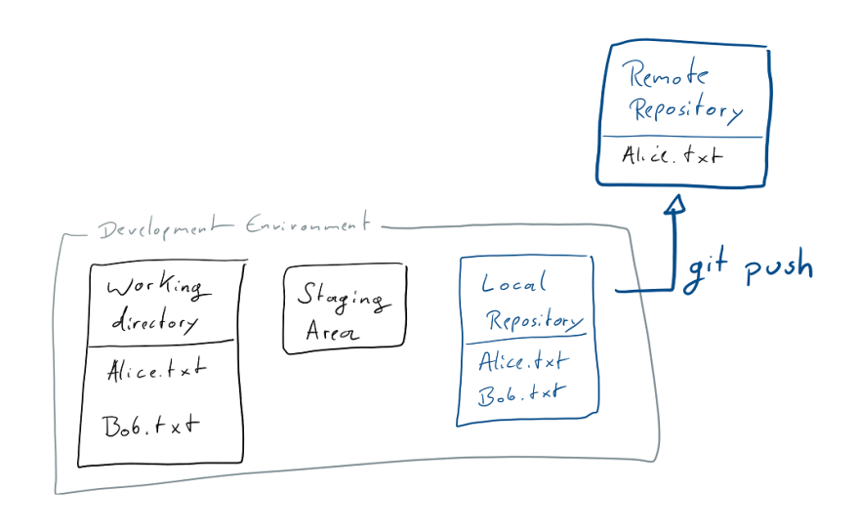
Now, share your commit with the Remote Repo: git push

Slide 19
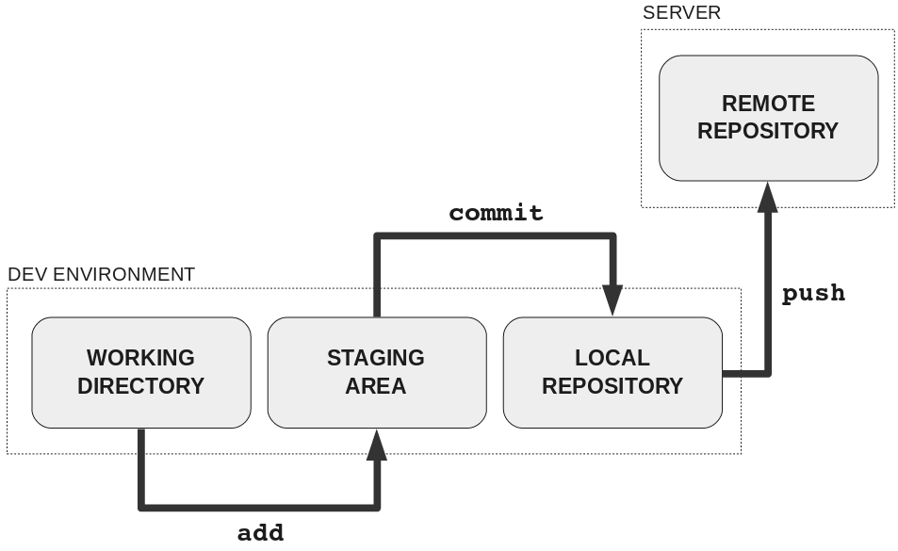

Slide 20
Very Brief Collaboration Discussion
Once a project has multiple developers / users, how to you foster collaboration?
You don’t want to be emailing file updates to each other
You don’t want to have a shared Dropbox that you’re both editing simultaneously
You don’t want to be working on the same files on separate computers without some way of seeing what changed to easily reconcile the updates
Distributed version control tools (like Git) provide solutions to these problems
The #1 solution are branches and merging

Slide 21
Collaboration Use Case
You’ve been assigned a portion of the project to complete: ModuleA
You clone the repo to your local computer
You build and test the project to make sure it’s in a good state to start working from
You make a branch from the starting code to do your work in.
Changes to the branch won’t be visible to the other branches until you merge those changes in
You work in your branch until you feel ModuleA is complete
(Ideally) You issue a merge request to your team for them to look at your work and then accept your code back into the master branch
Once your branch is merged, everyone else runs a git pull to sync their local repos up and now they have your ModuleA added to the project

Slide 22
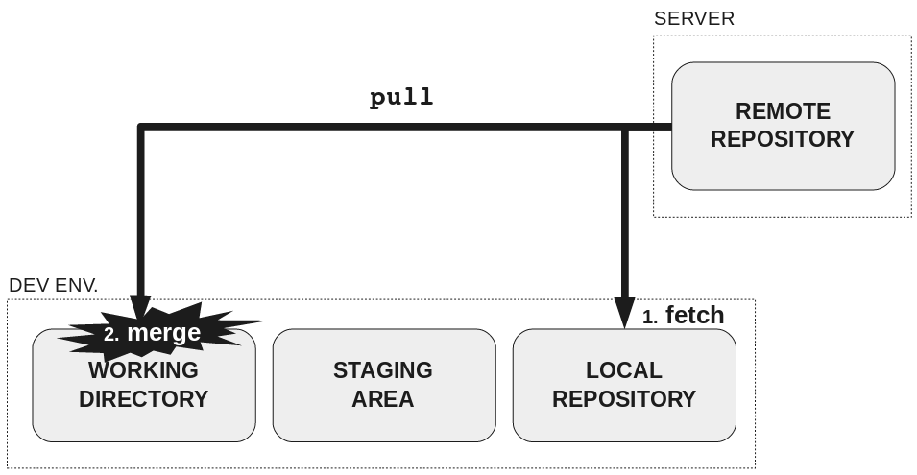

Slide 23
This sounds amazing!!!! How do I get started?
First, install git:
Linux Debian: apt install git
Linux RedHat: yum install git
Windows: https://git-scm.com/
OSX: git --version (it’ll install it if it isn’t there - it’s part of XCode)
Then, probably make an account on a server to host your repos:
gitlab.eecs.wsu.edu (hosted at WSU)
gitlab.com (non-academic projects)
Probably declare your repos private unless you want to share the code with the world

Slide 24

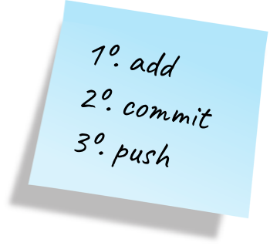
Create your first repo
Click “create project”
That’s for making a repo and other tools
Then, clone using https:
git clone https://aslkdfjlasjkfdlkasjfdlkjsafd →
Add your collaborators as members
Get workin!
Make a branch for yourself and start editing things
DO NOT WORK ON MASTER BRANCH DIRECTLY
As a matter of habit, always work in a branch and merge it in when you’re done

Slide 25
How to merge?
Officially, you fetch the current origin, change to the branch you want to merge into and run git merge [other branch name]
For people new to this… create a merge request
Goto the web interface and choose “merge requests”
Create a new merge request and choose the branches to merge from and to
If you haven’t caused any merge conflicts (by two people editing the same file on different branches)
Click the green button
Then everyone can git fetch & git merge or git pull to get the new updates

Slide 26

Where to learn more?
There’s TONS of info on Git
It’s the world’s most often used version control system
Every company that you want to work for uses a version control system
These days it is probably git, or will be soon
Net result: LOTS of documentation and tools
There’s no substitute for practice with this. Make a throwaway repository and start trying to add, update, commit, push, pull, branch, merge, etc.

